Slide 1




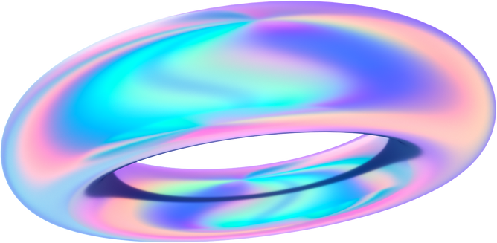

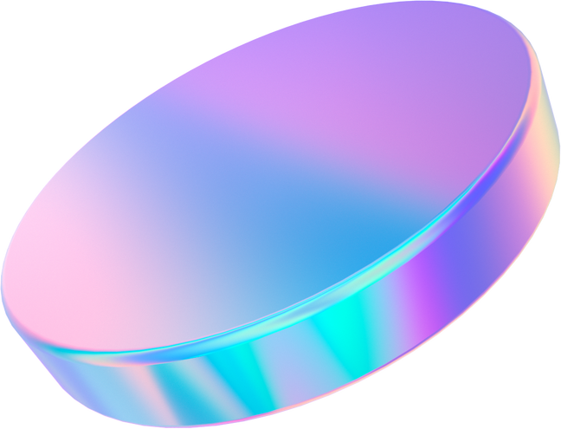
AI Sonnets
Getting the golden era back

Slide 2
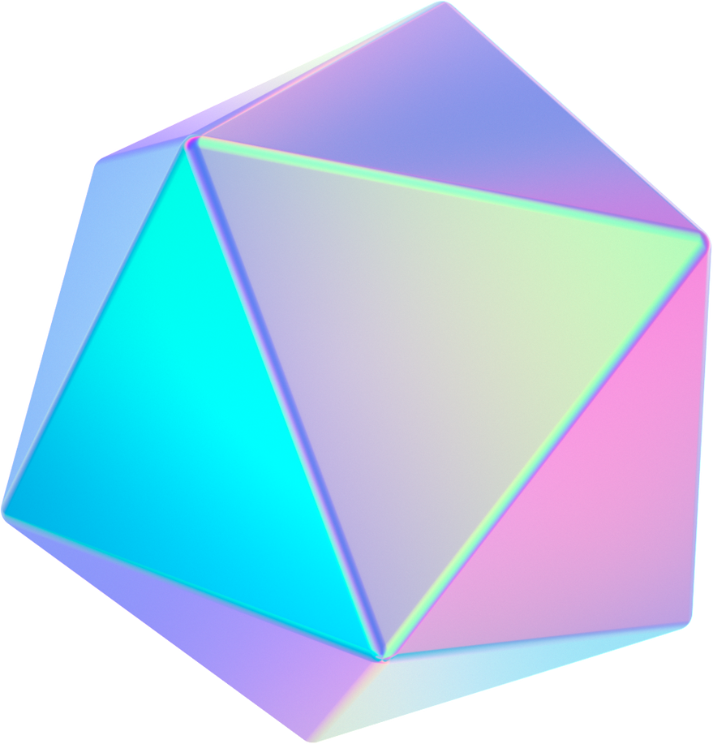


GAN
A Generative Adversarial Network (GAN) is a machine learning (ML) model in which two neural networks compete with each other by using deep learning methods to become more accurate in their predictions.

Slide 3
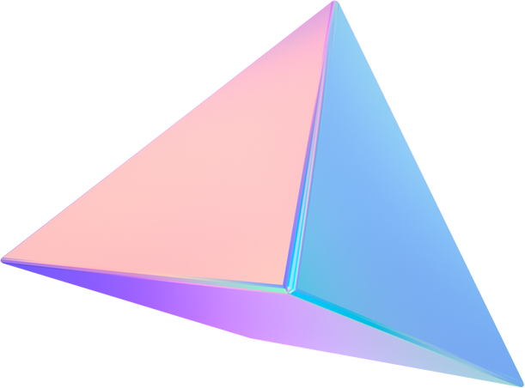
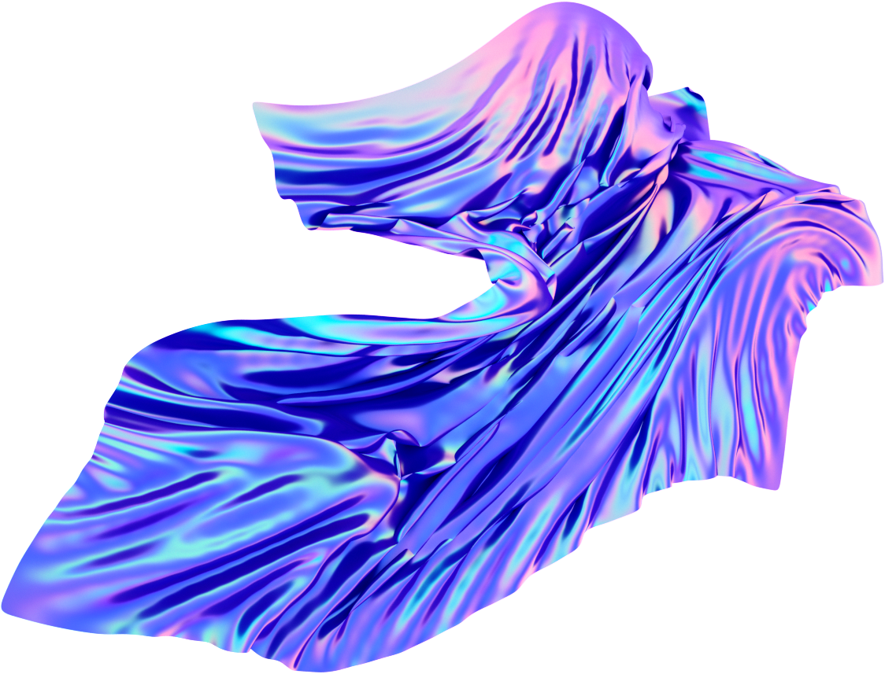
About the Project
Using Generative Adversarial Network to create a promising generator that would generate Shakesphere-like Sonnets.

Slide 4
What is a sonnet?
A sonnet typically consists of 14 lines, with each line containing 10 syllables, and a specific pattern of rhyme.
Shakespeare's 154 sonnets are important English poetry, with Sonnet 18 - 'Shall I Compare Thee to a Summer's Day?' - recognized as a highly romantic poem by many critics.
The 154 sonnets in Shakespeare's collection are standalone poems that interconnect to tell a love story. The poet expresses adoration for a young man, then turns his affections to a woman. These characters are used to break down the sonnets for analysis.

Slide 5


Team
Rithuraj Nambiar
Developer

Slide 6
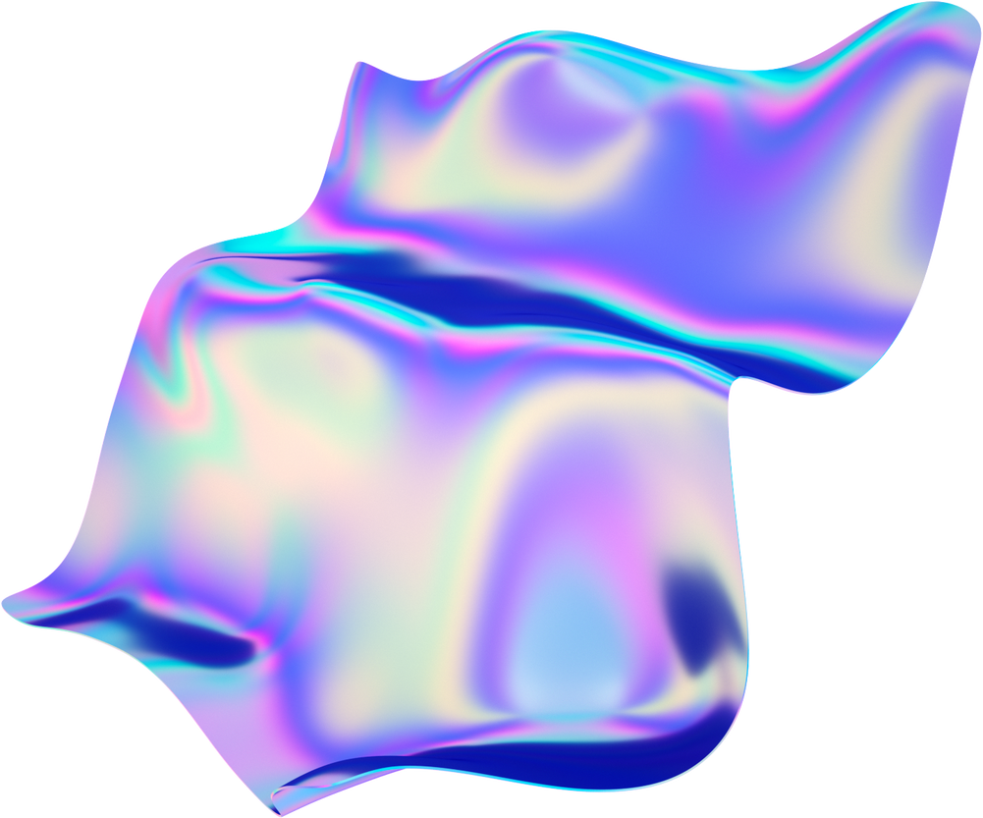
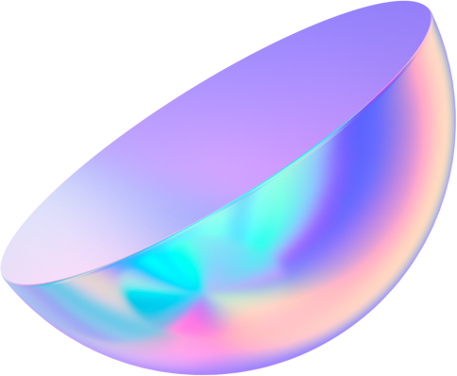
Importance of Poetry
Emotional Expression
Cultural significance
Historical perspective
Poetry can express emotions in a way that prose cannot.
Poetry can convey complex feelings and experiences that are difficult to articulate in other forms of writing.
Poetry has played an important role in many cultures throughout history.
It has been used to preserve cultural traditions, to celebrate important events, and to express the values and beliefs of a community.
Poetry can provide insight into the past and help us understand the attitudes and values of people in other times and places.
Many poets have written about historical events and social issues, providing a window into the past.

Slide 7
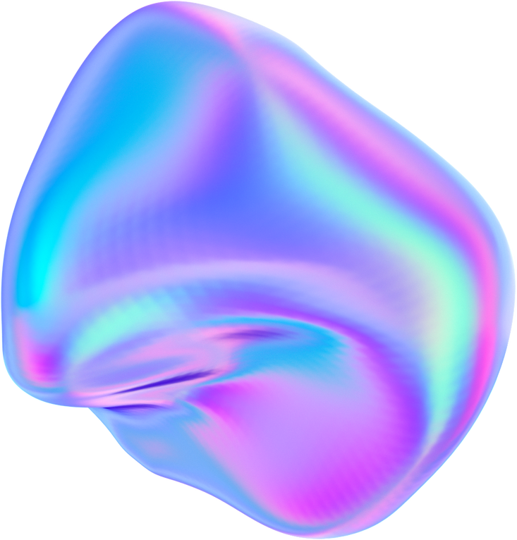





AI GENERATED POETRY
Training machine learning models on vast amounts of written texts to generate poems that imitate human-like language and style.
These models use complex algorithms to analyze and understand the patterns and structures of language, allowing them to generate unique and creative pieces of poetry that are often indistinguishable from human-written ones.
AI-generated poetry has various potential applications, including creative writing, marketing, and entertainment.
Additionally, it offers a new and exciting way to explore the boundaries of artificial intelligence and its ability to replicate human creativity.
THE SOLUTION

Slide 8
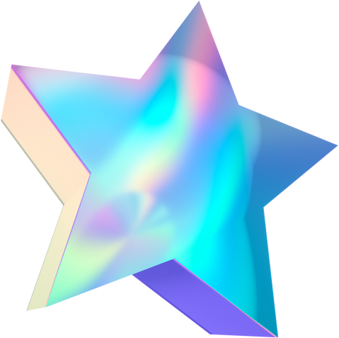
Uniqueness
The data used for this project is solely "Sonnets by William Shakespeare"
Use of cutting-edge technology like GAN (Generative Adversarial Network)

Slide 9







Marketing agencies would benifit a lot from these as it would help them generate promotional poems.
Impact on World
AI-generated poems can explore new ideas and concepts that humans may not have considered.
AI-generated poems can be written in a wide range of styles and formats, allowing for greater diversity in the poetry community.

Slide 10
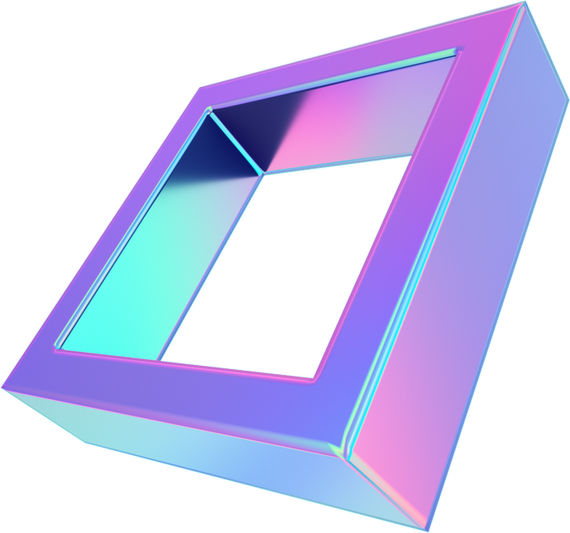
Thank You

